Slide 1


Francesco Cardinale
15/01/2024

Slide 2

Outline
Executive Summary
Introduction
Methodology
Results
Conclusion
Appendix

Slide 3
Executive Summary
Summary of Methodologies
Data Collection: Acquisition of historical data relating to past launches, sites and Falcon 9
Data Wrangling: Cleaning and transforming data for analysis
Exploratory Data Analysis (EDA): Understanding dataset characteristics
Visual Analytics: Leveraging Maps and Dashboard for interactive analysis
Predictive Analysis: Implementing Machine learning models for landing predictions
Summary of all Results
Temporal Trend Analysis: Success rates have improved since 2013
Launch Site Impact: Varying success rates at different launch sites
Attribute Correlation: Identifying attributes influencing successful landings
Visual Analytics Dashboard: Interactive tool for stakeholders

Slide 4
Introduction
Project background and context
Space X advertises Falcon 9 rocket launches on its website with a cost of 62 million dollars; Other providers cost upward of 165 million dollars each, much of the savings is because Space X can reuse the first stage. Therefore, if we can determine if the first stage will land, we can determine the cost of a launch. This information can be used if an alternate company wants to bid against space X for a rocket launch. This goal of the project is to create a machine learning pipeline to predict if the first stage will land successfully.
Problems we want to find answers
Determine if the Falcon 9 first stage will land successfully
Impact on launch cost and overall efficiency
Explore influential features for predicting successful landings

Slide 5

Section 1

Slide 6
Methodology
Executive Summary
Data collection methodology:
Data collection using SpaceX API and web scraping from Wikipedia
Perform data wrangling
Ensure data quality through cleaning, handling missing values, and one-hot encoding
Perform exploratory data analysis (EDA) using visualization and SQL
Perform interactive visual analytics using Folium and Plotly Dash
Perform predictive analysis using classification models
Build models with various algorithms, tune hyperparameters using GridSearch, and evaluate performance by scoring with suitable metrics

Slide 7
Data Collection
SpaceX API Data Collection:
Perform a GET request to SpaceX API for launch data.
Filter data for Falcon 9 launches.
Address missing values by replacing with the calculated mean for PayloadMass.
Web Scraping Data Collection:
Request Falcon 9 Launch Wiki page.
Use BeautifulSoup to parse HTML and extract launch records.
Extract column/variable names from HTML table header.
Create a DataFrame with parsed launch HTML tables.

Slide 8
Data Collection – SpaceX API
SpaceX API Calls
Initiate GET request to SpaceX API for launch data.
Filter for Falcon 9 Launches
Parse and filter the DataFrame to include only Falcon 9 launches
Handling Missing Values
Calculate mean for PayloadMass
Distinct API calls for targeted data extraction, like booster names, launch site details, payload information and core landing specifics
Replace NaN values with calculated mean
Export Processed Data
Save the processed dataset to CSV
GitHub URL: Data Collection SpaceX API Notebook

Slide 9
Data Collection - Scraping
HTML scraping and parsing
Perform a GET request to the Falcon 9 Launch Wiki page
Extract Column Names
Parse the HTML table to acquire variable names
Create Dataframe and Export Processed data
Use parsed HTML tables to create a Pandas DataFrame
Utilize BeautifulSoup for HTML parsing
Save the processed Dataset to CSV
GitHub URL: Data Wrangling SpaceX Notebook

Slide 10
Data Wrangling
Load data
Use Pandas to load the SpaceX dataset prepared in Data Collection stage
Analyze Data
Launch Sites
Create Landing Outcome Labels
Generate binary labels (0 or 1) based on successful or unsuccessful landings
Orbits
Mission Outcomes
Calculate Success Rate
Export Processed Data
Determine the success rate of landings
Save the processed dataset to CSV
GitHub URL: Data Collection SpaceX WebScraping Notebook

Slide 11
EDA with Data Visualization
FlightNumber vs. PayloadMass: Scatter plot showing that higher FlightNumber correlates with a higher chance of success, while heavier payloads tend to have a lower success rate.
FlightNumber vs. LaunchSite: Scatter plot revealing the relationship between FlightNumber and LaunchSite, indicating different success rates at various launch sites.
Payload vs. LaunchSite: Scatter plot demonstrating that, for the VAFB-SLC launch site, there are no launches for heavy payloads (above 10000).
Orbit Success Rate: Bar chart displaying success rates for different orbits.
FlightNumber vs. Orbit: Scatter plot indicating the relationship between FlightNumber and Orbit, highlighting success patterns in LEO orbits.
Payload vs. Orbit: Scatter plot illustrating the payload's impact on success rates in different orbits.
Launch Success Yearly Trend: Line chart depicting the increasing trend in average success rates from 2013 onwards.
GitHub URL: EDA Data Visualization SpaceX Notebook

Slide 12
EDA with SQL
Dataset Overview: SpaceX dataset captures payload records from historic missions.
SQL Queries: Executed queries to identify unique launch sites, filter records by launch site prefix, and calculate payload metrics.
Mission Outcomes: Analyzed mission outcomes, determining total payload mass for NASA (CRS) and average payload mass for F9 v1.1 boosters.
Landing Success: Explored successful landing dates, boosters achieving drone ship success with specific payload mass ranges.
Temporal Trends: Investigated trends from 2015, listing booster names with failure outcomes and ranked landing outcomes between 2010-2017.
GitHub URL: EDA with SQL Notebook

Slide 13
Build an Interactive Map with Folium
Launch Site Markers
Purpose: To visually represent the exact locations of each launch site.
Reasoning: Essential for understanding the spatial distribution of launch facilities.
Marker Clusters
Purpose: Highlight success/failure outcomes at each site.
Reasoning: Provides an immediate overview of success rates at each launch site. Clustering prevents map clutter.
Distance Markers and Polylines
Purpose: Show distances between launch sites and key features (coastline, highway, railroad, city).
Reasoning: Offers insights into strategic placement considerations, such as safety distances from cities and proximity to transportation infrastructure.
GitHub URL: Interactive Map with Folium Notebook

Slide 14
Build a Dashboard with Plotly Dash
Launch Site Drop-down
Purpose: Select different launch sites
Reasoning: Analyze success counts and rates by launch site
Callback Function for success-pie-chart
Purpose: Render a dynamic pie chart showing launch success counts
Reasoning: Visually compare success counts for all or a selected site
Range Slider for Payload (dcc.RangeSlider)
Purpose: Choose payload ranges
Reasoning: Explore correlation between payload mass and launch success
Success Payload Scatter Chart
Purpose: Generate scatter plot showing payload mass vs. launch success, color-labeled by booster version
Reasoning: Explore correlations between payload, booster versions, and launch outcomes
GitHub URL: Dashboard with Plotly Dash

Slide 15
Predictive Analysis (Classification)
Data Loading
Loaded data from two CSV files using URLs.
Data Preprocessing
Created a binary target variable 'Class' based on first stage landing success
Train-Test Split
Model
Performance Evaluation
Evaluated model performance using accuracy scores on Test Set
Utilized Pandas to create DataFrames for analysis.
Standardized the feature variables using StandardScaler
Split the data into training and testing sets (80/20 split).
Logistic Regression, Support Vector Machine, Decision Tree and KNN
Performed hyperparameter tuning using GridSearchCV
GitHub URL: Predictive Analysis Notebook

Slide 16
Results
Exploratory data analysis results
Interactive analytics demo in screenshots
Predictive analysis results

Slide 17

Section 2

Slide 18
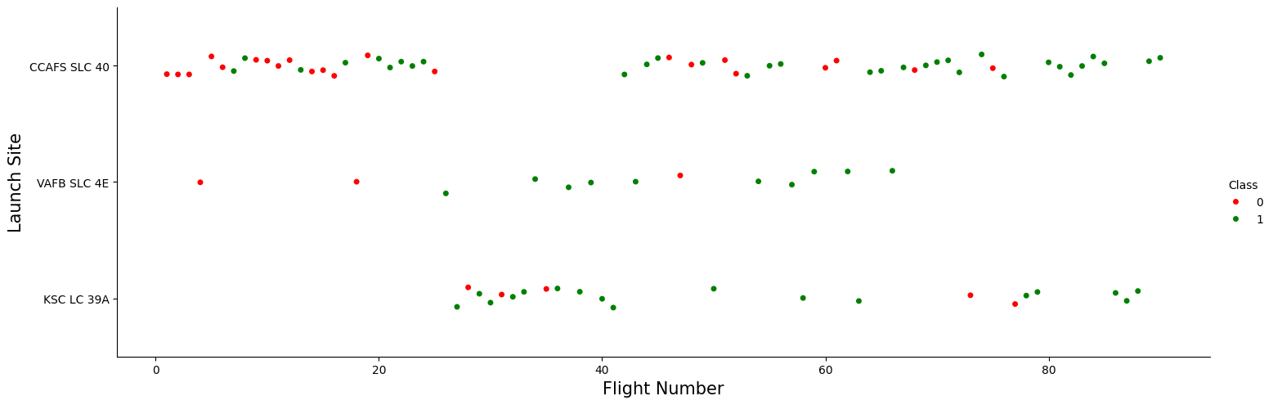
Flight Number vs. Launch Site
In the early flights, there is a cluster of unsuccessful launches primarily from CCAFS SLC 40
Over time, as Flight Number increases, the success rate improves
CCAFS SLC 40 has a higher concentration of unsuccessful launches compared to other sites

Slide 19
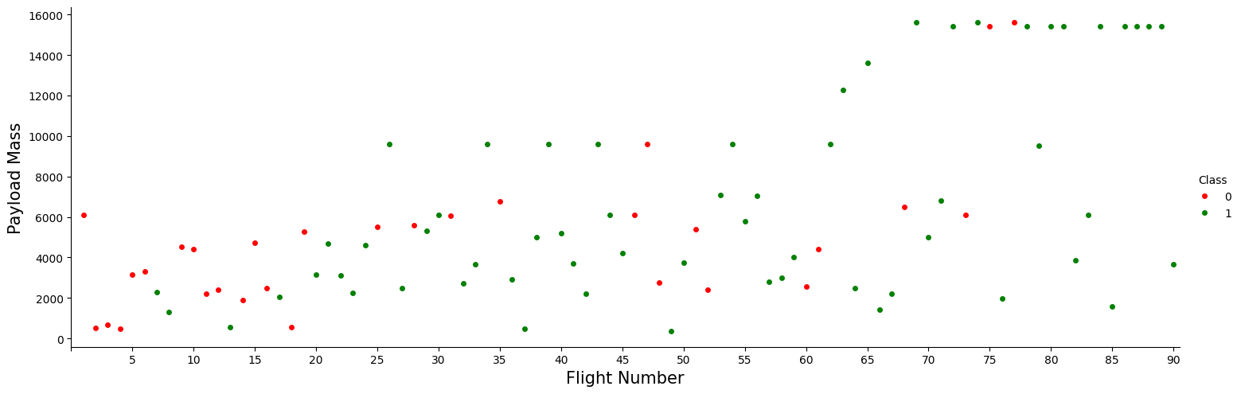
Payload vs. Launch Site
Payload mass varies widely, ranging from a few hundred to over 15,000 kg.
Unsuccessful launches are scattered across different payload masses.
There is a concentration of unsuccessful launches with lower payload masses.

Slide 20
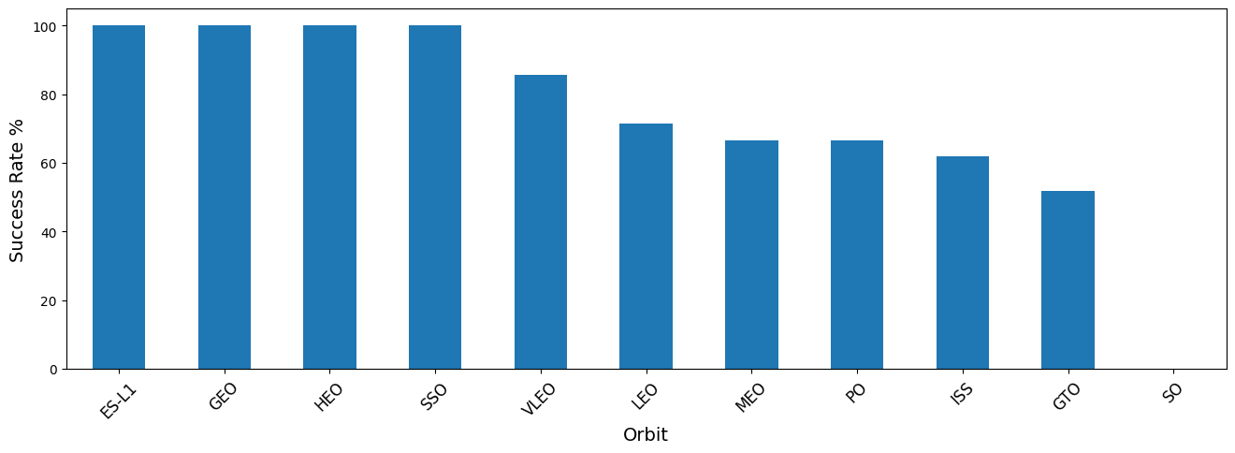
Success Rate vs. Orbit Type
ES-L1, GEO, HEO, and SSO orbits boast a perfect 100% success rate
VLEO, LEO, MEO, PO, ISS, and GTO exhibit success rates ranging from 51.85% to 85.71%
GTO experiences a lower success rate, while Suborbital missions show 0% success

Slide 21
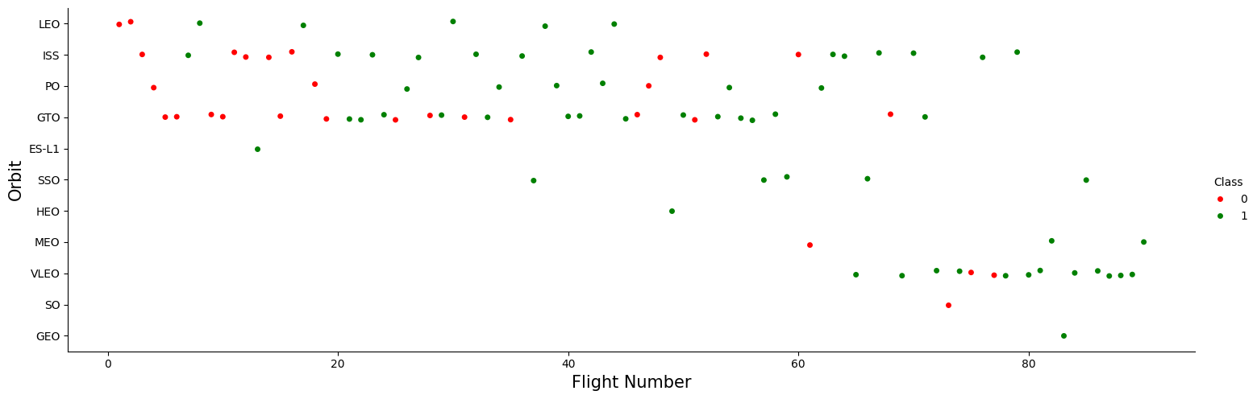
Flight Number vs. Orbit Type
Success in LEO orbit appears to correlate positively with the flight number
No clear relationship is observed between flight number and success in GTO orbit
Various orbits like ISS, PO, HEO, SSO, VLEO, MEO, GEO show mixed patterns, with success influenced by factors beyond the flight number

Slide 22
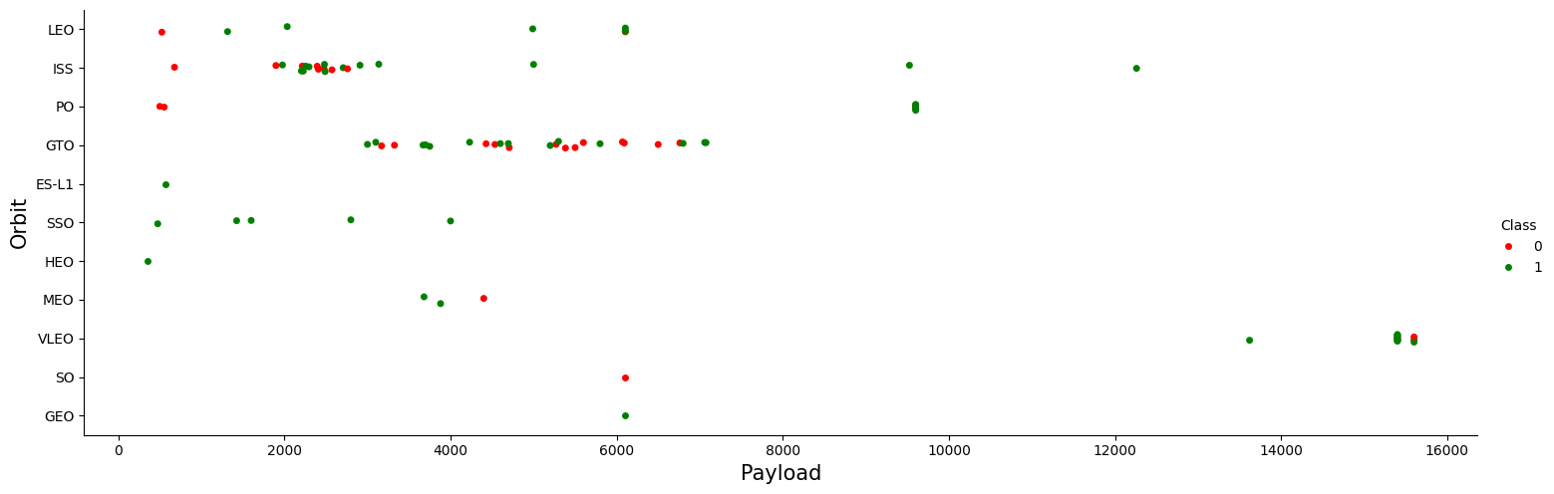
Payload vs. Orbit Type
Polar (SSO), LEO, ISS: High payload masses correlate with success
GTO Orbit: Payload mass alone doesn't distinctly predict success
Overall: Payload impact varies by orbit

Slide 23
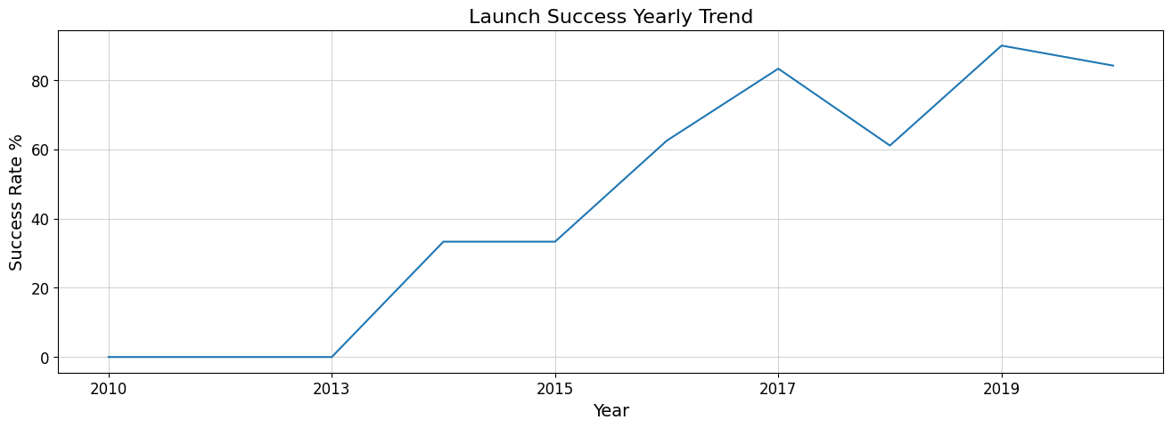
Launch Success Yearly Trend
2010-2014: Low and erratic success rates, with a slight increase in 2014
2015-2017: Significant improvement, with a steady increase each year
2018-2020: Success rates consistently high, peaking in 2019

Slide 24
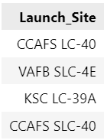
All Launch Site Names
SELECT DISTINCT Launch_Site FROM SPACEXTABLE
The query retrieves distinct launch site names from the SPACEXTABLE, identifying the unique locations where SpaceX launches have taken place.
The result lists four unique launch sites, namely CCAFS LC-40, VAFB SLC-4E, KSC LC-39A and CCAFS SLC-40.

Slide 25
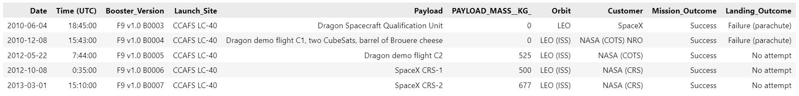
Launch Site Names Begin with 'CCA'
SELECT * FROM SPACEXTABLE WHERE Launch_Site LIKE 'CCA%' LIMIT 5
The SQL query selects all columns from the table where the Launch_Site column begins with the characters 'CCA'. The LIMIT 5 clause ensures that only the first 5 records meeting this condition are returned.
In the provided result, it’s possible to see details of launches from launch sites starting with 'CCA', which, in this case, corresponds to the 'CCAFS LC-40' launch site.

Slide 26
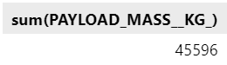
Total Payload Mass
SELECT sum(PAYLOAD_MASS__KG_) FROM SPACEXTABLE WHERE Customer LIKE 'NASA (CRS)'
The SQL query is used to calculate the total payload mass (in kilograms) of all SpaceX launches where the customer is specified as 'NASA (CRS)'. The function aggregates the payload masses for all records that meet the condition in the where clause.
The result of the query is 45596, indicating the total payload mass (in kilograms) for all SpaceX launches associated with NASA's Commercial Resupply Services (CRS) program.

Slide 27
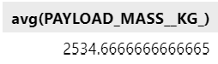
Average Payload Mass by F9 v1.1
SELECT avg(PAYLOAD_MASS__KG_) FROM SPACEXTABLE WHERE Booster_Version LIKE 'F9 v1.1%'
The SQL query is used to calculate the average payload mass (in kilograms) carried by booster versions that match the pattern 'F9 v1.1%' in the Booster_Version column. The avg function computes the average payload mass for all records that meet the condition specified in the where clause.
The result of the query is approximately 2534.67, indicating the average payload mass (in kilograms) for all SpaceX launches where the booster version is categorized as 'F9 v1.1%'.

Slide 28
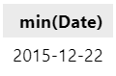
First Successful Ground Landing Date
SELECT min(Date) FROM SPACEXTABLE WHERE Landing_Outcome = 'Success (ground pad)'
The SQL query is used to find the earliest date when the first successful landing outcome on a ground pad was achieved. The min function is applied to the Date column, selecting the minimum (earliest) date from the records that meet the condition specified in the WHERE clause.
The result of the query is '2015-12-22', indicating that the first successful landing outcome on a ground pad occurred on December 22, 2015.

Slide 29
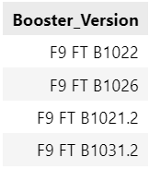
Successful Drone Ship Landing with Payload between 4000 and 6000
SELECT Booster_Version FROM SPACEXTABLE WHERE Landing_Outcome = 'Success (drone ship)' AND (PAYLOAD_MASS__KG_ BETWEEN 4000 AND 6000)
The SQL query is designed to retrieve the names of boosters that achieved success in a drone ship landing and had a payload mass greater than 4000 kg but less than 6000 kg.
The result of the query is a list of booster versions that successfully landed on a drone ship and carried a payload within the specified mass range.

Slide 30
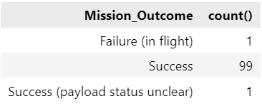
Total Number of Successful and Failure Mission Outcomes
SELECT Mission_Outcome, count() FROM SPACEXTABLE GROUP BY trim(Mission_Outcome)
The SQL query is designed to provide the total number of successful and failure mission outcomes.
The result of the query is a summary of the count of each unique mission outcome. This information provides an overview of the distribution of mission outcomes in terms of success and failure

Slide 31
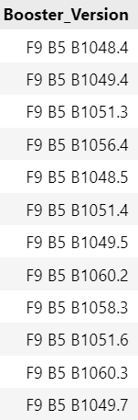
Boosters Carried Maximum Payload
SELECT distinct Booster_Version FROM SPACEXTABLE
WHERE PAYLOAD_MASS__KG_ = (SELECT MAX(PAYLOAD_MASS__KG_) FROM SPACEXTABLE)
The SQL query is designed to retrieve the names of booster versions that have carried the maximum payload mass.
The result of the query is a list of distinct booster versions that have carried the maximum payload mass. The list includes the booster versions such as F9 B5 B1048.4, F9 B5 B1049.4 and others, indicating these boosters achieved the maximum payload mass in the dataset

Slide 32
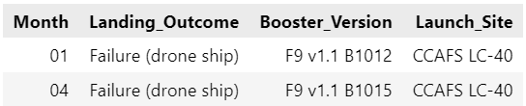
2015 Launch Records
SELECT substr(Date, 6, 2) as Month, Landing_Outcome, Booster_Version, Launch_Site
FROM SPACEXTABLE
WHERE substr(date, 0, 5) = '2015' AND Landing_Outcome = 'Failure (drone ship)'
The SQL query is designed to retrieve records that display month names, failure landing outcomes in drone ship, booster versions, and launch sites for the months in the year 2015.
The result shows entries for January (Month 01) and April (Month 04) in the year 2015 where the landing outcome was a failure on the drone ship.

Slide 33
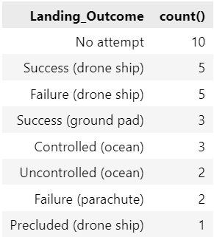
Rank Landing Outcomes Between 2010-06-04 and 2017-03-20
SELECT Landing_Outcome,
count()
FROM SPACEXTABLE
WHERE Date BETWEEN '2010-06-04' AND '2017-03-20'
AND (Landing_Outcome LIKE '%Success%' OR Landing_Outcome LIKE '%Failure%’)
GROUP BY Landing_Outcome
ORDER BY count() desc
This SQL query is designed to rank the count of landing outcomes, such as "Success (drone ship)" or "Failure (ground pad)," between the date '2010-06-04' and '2017-03-20' in descending order.
The result of the query is a table that ranks the count of different landing outcomes within the specified date range. The landing outcomes are grouped by their types, and the counts are presented in descending order.

Slide 34

Section 3

Slide 35
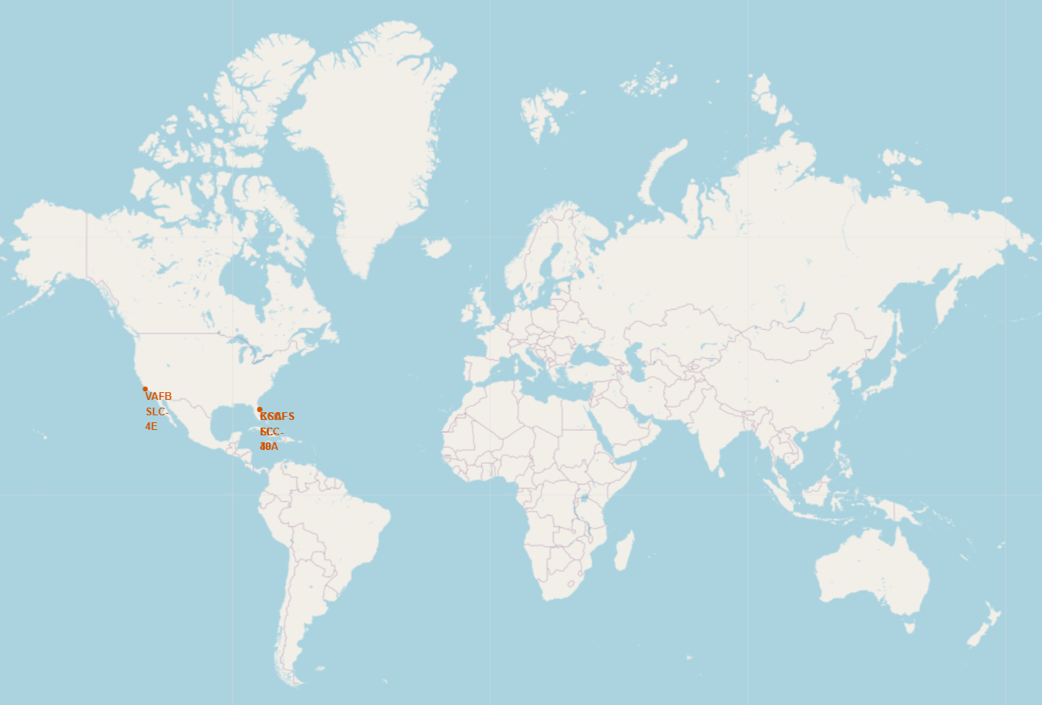
Global Launch Site Distribution
All launch sites are located in the United States:
Florida Launch Sites:
Cape Canaveral Air Force Station Launch Complex 40 (CCAFS LC-40)
Cape Canaveral Air Force Station Space Launch Complex 40 (CCAFS SLC-40)
Kennedy Space Center Launch Complex 39A (KSC LC-39A)
California Launch Site:
Vandenberg Air Force Base Space Launch Complex 4E (VAFB SLC-4E)

Slide 36
Success/Failed Launches for each Site
VAFB SLC-4E
KSC LC-39A
CCAFS LC-40
CCAFS SLC-40
Successful Launches: 4
Failed Launches: 6
Success Rate: 40 %
Successful Launches: 10
Failed Launches: 3
Success Rate: 76.9 %
Successful Launches: 7
Failed Launches: 19
Success Rate: 26.9 %
Successful Launches: 3
Failed Launches: 4
Success Rate: 42.9 %

Slide 37
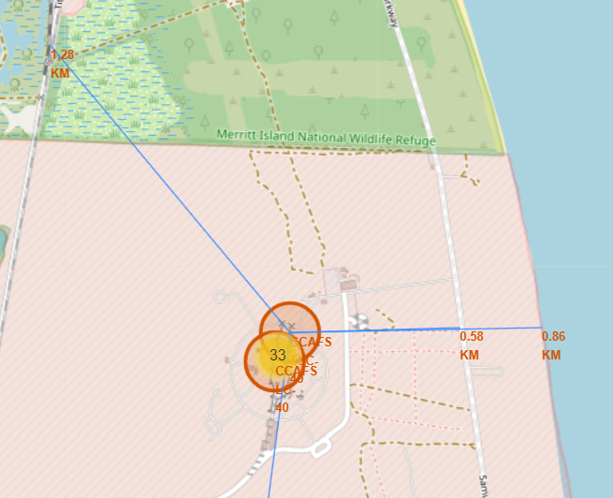
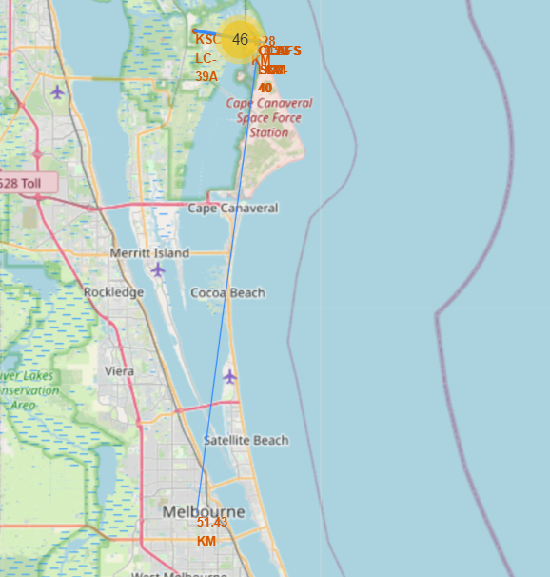
Proximity Analysis for Launch Site CCAFS SLC-40
Coastline Safety: Proximity to coastlines provides safety benefits, allowing for water landings in case of launch aborts and minimizing risks to populated areas from falling debris. (Distance from coastline: 0.86 km)
Highway Access: Launch sites are strategically located near highways for efficient transportation of personnel, equipment, and payloads, supporting the logistical needs of space missions. (Distance from highway: 0.58 km)
Railway Efficiency: Close proximity to railways facilitates the transport of heavy cargo, offering a cost-effective and efficient means of moving large payloads. (Distance from railway: 1.28 km)
Urban Distance: Launch sites are intentionally situated away from densely populated areas, minimizing risks and ensuring the safety of human life and property in case of launch failures. (Distance from city - Melbourne: 51.43 km)

Slide 38

Section 4

Slide 39
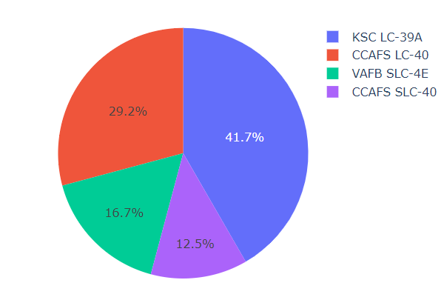
Total Success Launches by Site
The pie chart illustrates the distribution of successful launches among four launch sites:
KSC LC-39A (41.7%): Dominates with the highest success rate.
CCAFS LC-40 (29.2%): Contributes significantly to successful launches.
VAFB SLC-4E (16.7%): Plays a notable role in successful missions.
CCAFS SLC-40 (12.5%): Contributes to the overall success distribution.

Slide 40
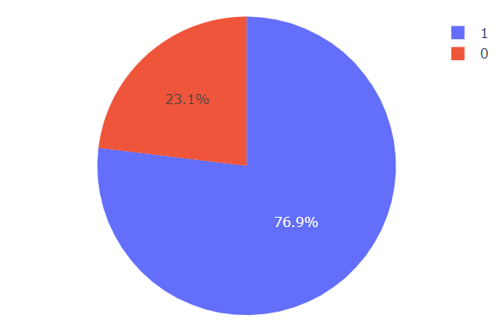
Total Success Launches for Site KSC LC-39A
The pie chart highlights the launch success ratio for the site with the highest success percentage:
KSC LC-39A
Success Rate (76.9%): Represents the proportion of successful launches
Failure Rate (23.1%): Indicates the percentage of unsuccessful launches from the same site.
This chart emphasizes KSC LC-39A's impressive success rate, demonstrating its effectiveness as a launch site with a majority of missions ending successfully.

Slide 41
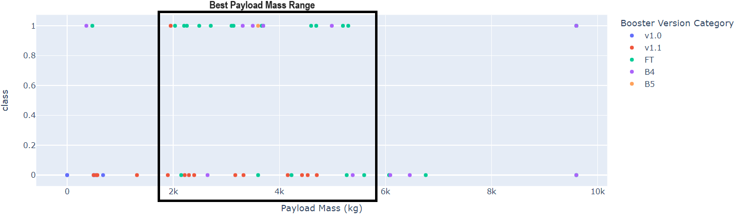
Success Rates: Payload Mass and Booster Versions
The scatter plot displays the relationship between Payload Mass, Launch Outcome (Success or Failure), and the associated Booster Version
Payload Range: The scatter plot shows that the most successful launches cluster within the payload mass range of approximately 1900 to 5500 kg.
The Booster Version Category "FT" stands out as having the highest success rate

Slide 42

Section 5

Slide 43
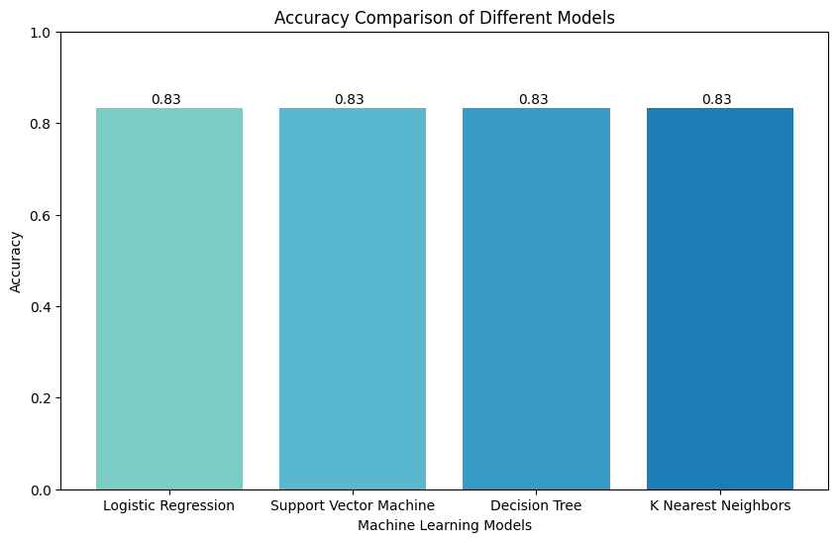
Classification Accuracy
The accuracy values for all models are the same: 83.33%

Slide 44

Confusion Matrix
The models, including Logistics Regression, Support Vector Machine, Decision Tree, and K Nearest Neighbors, have collectively correctly identified 3 instances as negative and 12 instances as positive.
They have made 3 false positive errors, incorrectly predicting 3 instances as positive when they were actually negative.
They have made 0 false negative errors, meaning they correctly predicted all positive instances.

Slide 45
Conclusions
Optimal Payload and Booster Version:
Payloads between 1900 - 5500 kg and booster version "FT" show the highest success rates.
Temporal Success Trends:
Success rates steadily increased since 2013, with notable peaks in 2016 and 2019.
Strategic Launch Site Positioning:
Launch sites strategically located for efficiency near the equator, coastline, highways, and railways.
Geographical Launch Distribution:
Launch sites concentrated in America, specifically in Florida and California.
CCAFS LC-40 and KSC LC-39A have more failed launches.
Unified Model Accuracy:
All classification models achieved a consistent high accuracy of 83.33%.
The models collectively performed well, with minimal false positives and no false negatives.

Slide 46
Conclusions
Optimal Payload and Booster Version
Payloads between 1900 - 5500 kg and booster version "FT" show the highest success rates
Temporal Success Trends
Success rates steadily increased since 2013, with notable peaks in 2016 and 2019
Strategic Launch Site Positioning
Launch sites strategically located for efficiency near the equator, coastline, highways, and railways
Geographical Launch Distribution
Launch sites concentrated in America, specifically in Florida and California
CCAFS LC-40 and KSC LC-39A have more failed launches
Unified Model Accuracy
All classification models achieved a consistent high accuracy of 83.33%
The models collectively performed well, with minimal false positives and no false negatives

Slide 47


